Slide 1
Testing Fundamentals
CSE 4495- Lecture 3 - 28/06/2022
Instructor : Md. Mohaiminul Islam

Slide 2
Verification
Ensuring that an implementation conforms to its specification.
AKA: Under these conditions, does the software work?
Proper V&V produces dependable software.
Testing is the primary verification activity.

Slide 3
We Will Cover
What is testing?
Definitions:
What are the components of a test case?
Testing stages:
Unit, System (Integration and Exploratory), and Acceptance Testing
Test planning considerations

Slide 4
Software Testing
Test Input
An investigation into system quality.
Based on sequences of stimuli and
observations.
SUT
Stimuli that the system must react to.
Observations of system reactions.
Verdicts on correctness.
Output
Test Oracle (Expected Output)
Verdict (Pass/Fail)

Slide 5

Bugs? What are Those?
Bug is an overloaded term.
Does it refer to the bad behavior observed?
Is it the source code mistake that led to that behavior?
Is it both or either?

Slide 6

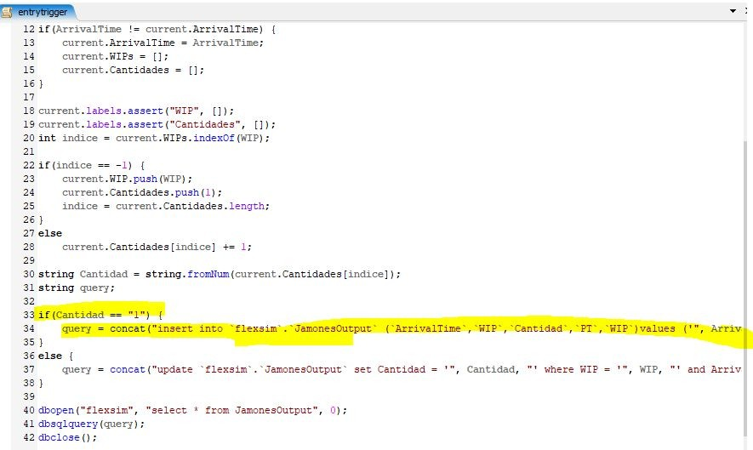
Faults and Failures
Failure
An execution that yields an incorrect result.
Fault
The problem that caused a failure.
Mistake in the code, omission from the code, misuse.
When we observe a failure, we
try to find the fault.

Slide 7
Software Testing
The main purpose of testing is to find faults:
“Testing is the process of trying to discover every conceivable fault or weakness in a work product”
- Glenford Myers
Tests must reflect normal system usage and extreme boundary events.

Slide 8
Testing Scenarios
Verification:
Demonstrate that software meets the specification.
Tests tend to reflect “normal” usage.
Any lack of conformance is a fault.
Resilience:
Show that software can handle rare/extreme situations.
Tests tend to reflect extreme usage.
Large volume of data, null data, malformed data, attacks.

Slide 9
Axiom of Testing
“Program testing can be used to show the presence of bugs, but never their absence.”
- Dijkstra

Slide 10
What Goes in a Test Case?

Slide 11
Test Suite and Test Case
A test suite is a collection of test cases.
Suite
Executed together.
Each test case should be independent.
C
C
ase
ase
C
Case
ase
May have multiple suites in one project.
Different types of tests, different resource/time needs.
A test case consists of:
Initialization, Test Steps, Inputs, Oracles, Tear Down

Slide 12
Anatomy of a Test Case
(I₁ O₁) (I₂ O₂ )
(I₃ O₃)
if O = Expected(O
)
Test Inputs
n
n
_{then…Pass}
How we “stimulate” the system.
else… Fail
Test Oracle
How we check the correctness of the resulting observation.

Slide 13
Anatomy of a Test Case
Initialization
Any steps that must be taken before test execution.
Test Steps
Interactions with the system, and comparisons between oracle and actual values.
Tear Down
Any steps that must be taken after test execution.

Slide 14
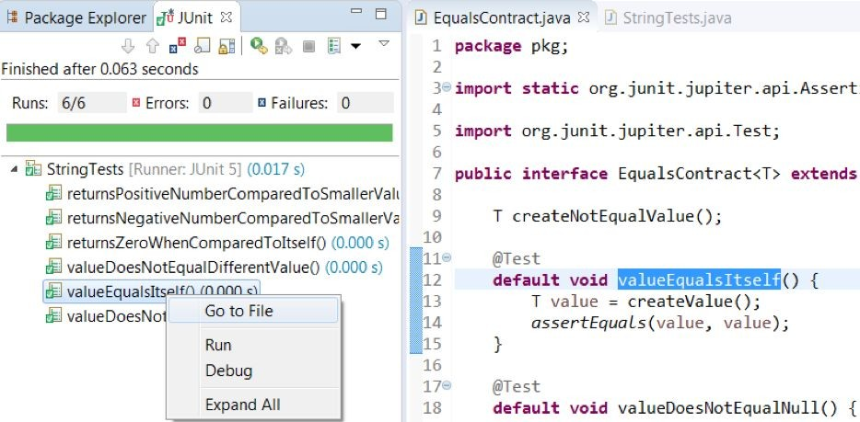
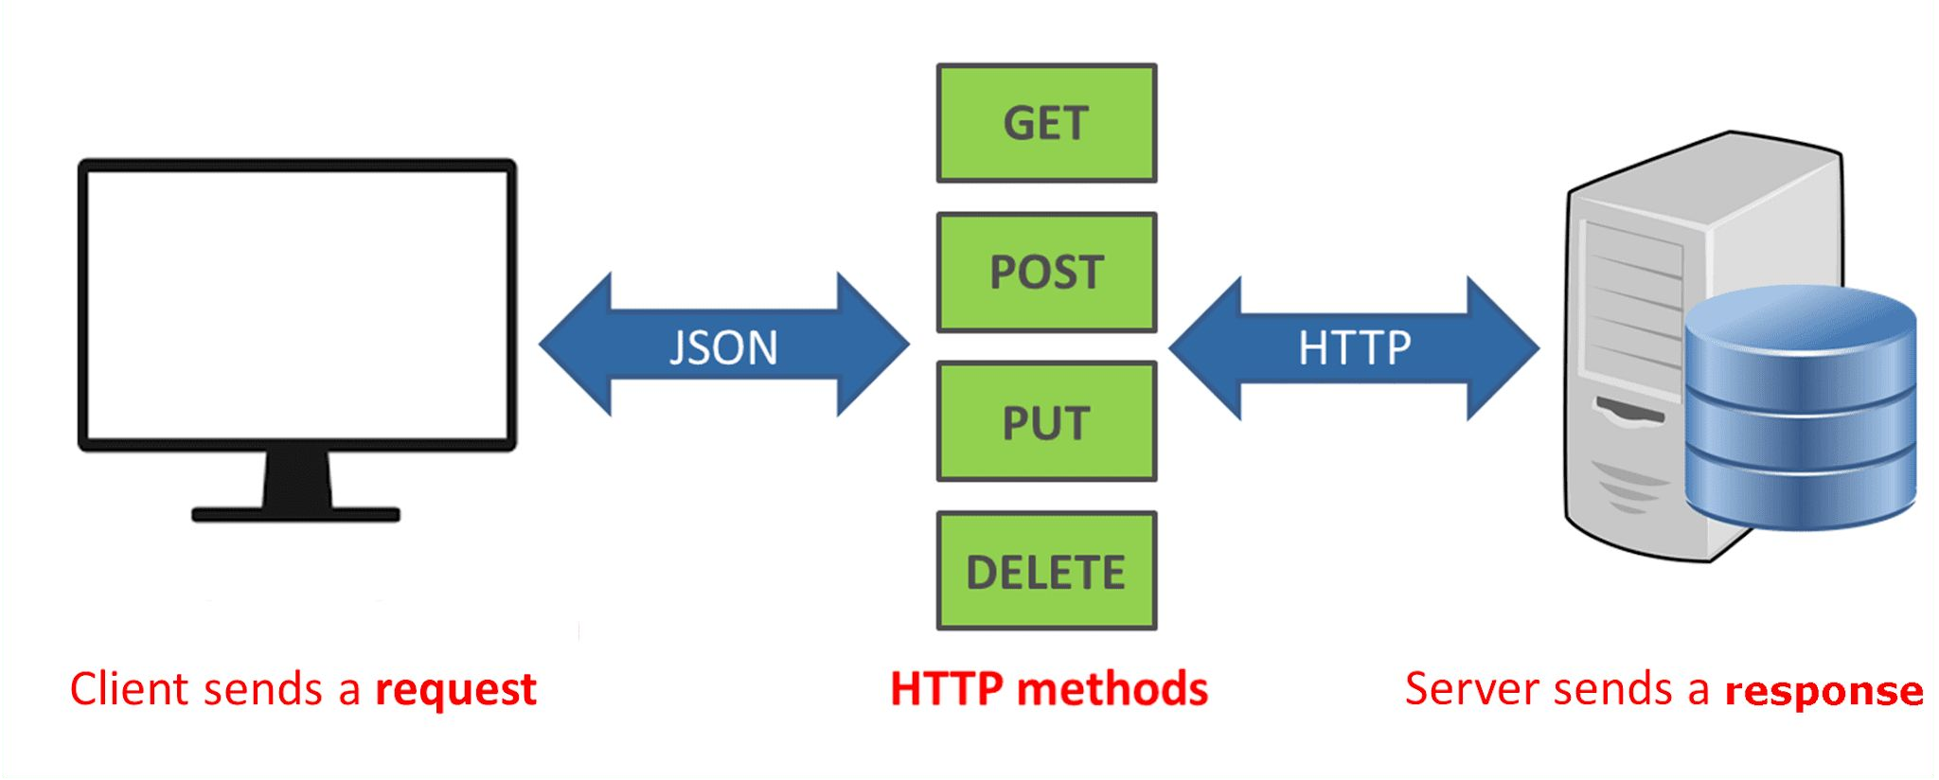
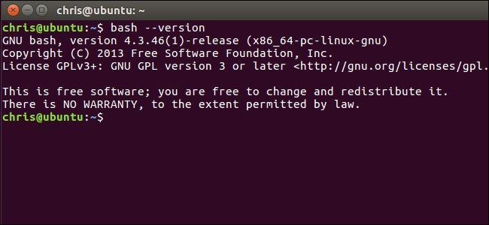

Test Input
Any deliberate interactions with a software feature.
Generally, calls a function through an interface.
Method Call
API Call
CLI Interaction
GUI Interaction

Slide 15


Test Input
Environment manipulation
Set up a database with particular records
Set up simulated network environment
Create/delete files
Control available CPU/memory/disc space
Timing
Before/at/after deadline
Varying frequency/volume of input

Slide 16
Test Creation and Execution
Can be human-driven
Exploratory testing, alpha/beta testing
or automated
Tests written as code
Testing frameworks (JUnit)
Frameworks for manipulating interfaces (Selenium)
Capture/replay tools can re-execute UI-based tests (SWTBot for Java)
Automated input generation (AFL, EvoSuite)

Slide 17
Sources of Input
Black Box (Functional) Test Design
Use knowledge about how the system should act to design test cases.
Requirements, comments, user manuals, intuition.
Tests can be designed before code is written.
(test-driven development)

Slide 18
Sources of Input
White Box (Structural) Test Design
Input chosen to exercise part of the code.
Usually based on adequacy criteria:
Checklists based on program elements.
Branch Coverage - Make all conditional statements evaluate to all outcomes (if-statements, switches, loops)
Fill in the gaps in black-box test design.

Slide 19
Test Oracle - Definition
A predicate that determines whether a program is correct or not.
Based on observations of the program.
Output, timing, speed, energy use, ...
Will respond with a pass or a fail verdict.
Can be specific to one test or more general.

Slide 20
Test Oracle Components
Oracle Information
Embedded information used to judge the correctness of the implementation, given the inputs.
Oracle Procedure
Code that uses that information and relevant observations to arrive at a verdict.
if (actual value != expected value) { fail (...); }
assertEquals(actual value, expected value);

Slide 21
Oracles are Code
Oracles must be developed.
Like the project, an oracle is built from the requirements.
… and is subject to interpretation by the developer
… and may contain faults
A faulty oracle can be trouble.
May result in false positives - “pass” when there was a fault in the system.
May result in false negatives - “fail” when there was not a fault in the system.

Slide 22
Expected-Value Oracles
Simplest oracle - what exactly should happen?
int expected = 7;
int actual = max(3, 7); assertEquals(expected, actual);
Oracle written for a single test case, not reusable.

Slide 23
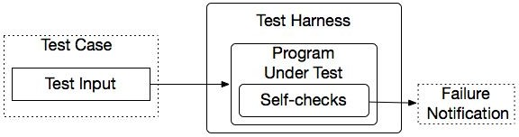
Property-based Oracles
Rather than comparing actual values, use properties about
results to judge sequences.
@Test
public void propertiesOfSort (String[] input) {
// Tests
String[] sorted = quickSort(input);
assert(sorted.size >= 1, "This array can’t be empty.")
for (int item = 1; item < sorted.length; item++)
assert(sorted[item] > sorted[item - 1], “Items
should be sorted in ascending order”);
}
Uses assertions, contracts, and other logical properties.

Slide 24
Properties
Usually written at “function” level.
For a method or high-level API/UI function.
Properties based on behavior of that function.
Work for any input to that function.
Trade-off: limited by number of properties.
Faults missed even if specified properties are obeyed.
More properties = more expensive to write.

Slide 25
Implicit Oracles
Check properties expected of any program.
Crashes and exceptions.
Buffer overruns.
Deadlock.
Memory leaks.
Excessive energy usage or downloads.
Faults that do not require expected output to detect.

Slide 26
Testing Stages

Slide 27
Testing Stages
API
GUI
CLI
We interact with systems
through interfaces.
APIs, GUIs, CLIs
Systems built from subsystems.
With their own interfaces.
Subsystems built from units.
API
API
Communication via method calls.
Set of methods is an interface.

Slide 28
Testing Stages
API
GUI
CLI
Unit Testing
Do the methods of a class work?
System-level Testing
System (Integration) Testing
API
(Subsystem-level) Do the collected units work?
(System-level) Does high-level interaction through APIs/UIs work?
API
Exploratory Testing
Does interaction through GUIs work?

Slide 29

Testing Stages
Acceptance Testing/ AB Testing
Give product to a set of users to check whether it meets their needs.
Alpha/beta Testing - controlled pools of users, generally on their own machine.
Acceptance Testing - controlled pool of customers, in a controlled environment, formal acceptance criteria
Can expose many faults.
Can be planned during requirements elicitation.

Slide 30
Let’s take a break.

Slide 31
The V-Model of Development
Requirements Elicitation
Acceptance Test Plan
Operation and Maintenance
System and Exploratory Test Plan
System Specification
Acceptance Testing
Architectural Design
Subsystem Test Plan
System and Exploratory Testing
Detailed Design
Subsystem Testing
Unit Test Plan
Unit Development and Testing

Slide 32
Unit Testing
Testing the smallest “unit” that can be tested.
Often, a class and its methods.
Tested in isolation from all other units.
Mock the results from other classes.
Test input = method calls.
Test oracle = assertions on output/class variables.

Slide 33
Unit Testing
Account
name personnummer balance
Account (name, personnummer, Balance) withdraw (double amount) deposit (double amount) changeName(String name) getName() getPersonnummer() getBalance()
For a unit, tests should:
Test all “jobs” associated with the unit.
Individual methods belonging to a class.
Sequences of methods that can interact.
Set and check class variables.
Examine how variables change after method calls.
Put the variables into all possible states (types of values).

Slide 34
System (Integration) Testing
After testing units, test their integration.
Integrate units in one subsystem.
Then integrate the subsystems.
Test input through a defined interface.
Focus on showing that functionality accessed through interfaces is correct.
Subsystems: “Top-Level” Class, API
System: API, GUI, CLI, …

Slide 35
System Testing
Subsystem made up classes of A, B, and C. We have performed unit testing...
Test Cases
Classes work together to perform subsystem functions.
Tests applied to the interface of the subsystem they form.
Errors in combined behavior not caught by unit testing.
A
B
C

Slide 36
GUI Testing
Tests designed to reflect end-to-end user journeys.
From opening to closing.
Often based on scenarios.
GUI Testing
Deliberate tests, specific input.
May be automated or human-executed.
Exploratory Testing
Open-ended, human-driven exploration.

Slide 37
Exploratory Testing
Tests are not created in advance.
Testers check the system on-the-fly.
Guided by scenarios.
Often based on ideas noted before beginning.
Testing as a thinking idea.
About discovery, investigation, and role-playing.
Tests end-to-end journeys through app.
Test design and execution done concurrently.

Slide 38
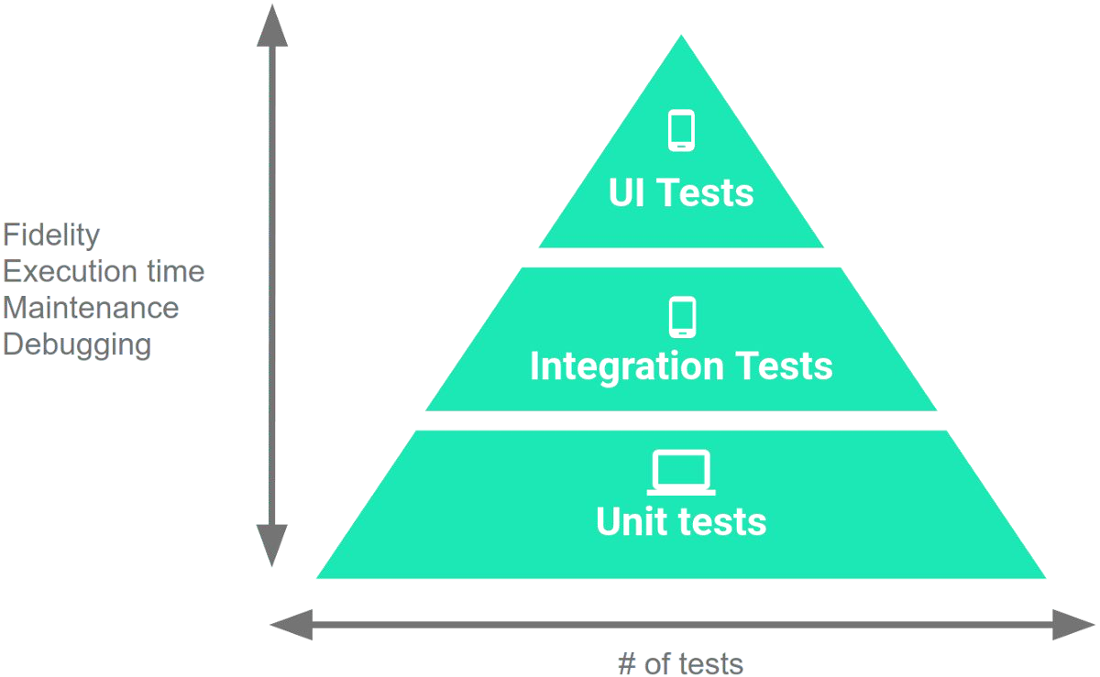
Testing Percentages
Unit tests verify behavior of a single class.
70% of your tests.
System tests verify class interactions.
20% of your tests.
GUI/exploratory tests verify end-to-end journeys.
10% of your tests.

Slide 39
Testing
70/20/10 recommended.
Unit tests execute quickly, relatively simple.
System tests more complex, require more setup, slower to execute.
UI tests very slow, may require humans.
Well-tested units reduce likelihood of integration issues, making high levels of testing easier.

Slide 40
Acceptance Testing
Once the system is internally tested, it should be placed in the hands of users for feedback.
Users must ultimately approve the system.
Many faults only emerge in the wild.
Alternative operating environments.
More eyes on the system.
Wide variety of usage types.

Slide 41
Acceptance Testing Types
Alpha Testing
A small group of users work closely with development team to test the software.
Beta Testing
A release of the software is made available to a larger group of interested users.
Formal Acceptance Testing
Customers decide whether or not the system is ready to be released.

Slide 42
Acceptance Testing Stages
Define acceptance criteria
Work with customers to define how validation will be conducted, and the conditions that will determine acceptance.
Plan acceptance testing
Decide resources, time, and budget for acceptance testing. Establish a schedule. Define order that features should be tested. Define risks to testing process.

Slide 43
Acceptance Testing Stages
Derive acceptance tests.
Design tests to check whether or not the system is acceptable. Test both functional and non-functional characteristics of the system.
Run acceptance tests
Users complete the set of tests. Should take place in the same environment that they will use the software. Some training may be required.

Slide 44
Acceptance Testing Stages
Negotiate test results
It is unlikely that all of the tests will pass the first time. Developer and customer negotiate to decide if the system is good enough or if it needs more work.
Reject or accept the system
Developers and customer must meet to decide whether the system is ready to be released.

Slide 45
We Have Learned
What is testing?
Testing terminology and definitions.
Input, oracles
Faults, failures
Testing stages include unit testing, system testing, exploratory/GUI testing, and acceptance testing.

Slide 46
Next Time
Next lecture: System Testing
Optional reading: Pezze and Young, Ch 10-11

Slide 47
Thank You

